Slide 1
Lab 6: Differential Gene Expression
PLB 812

Slide 2
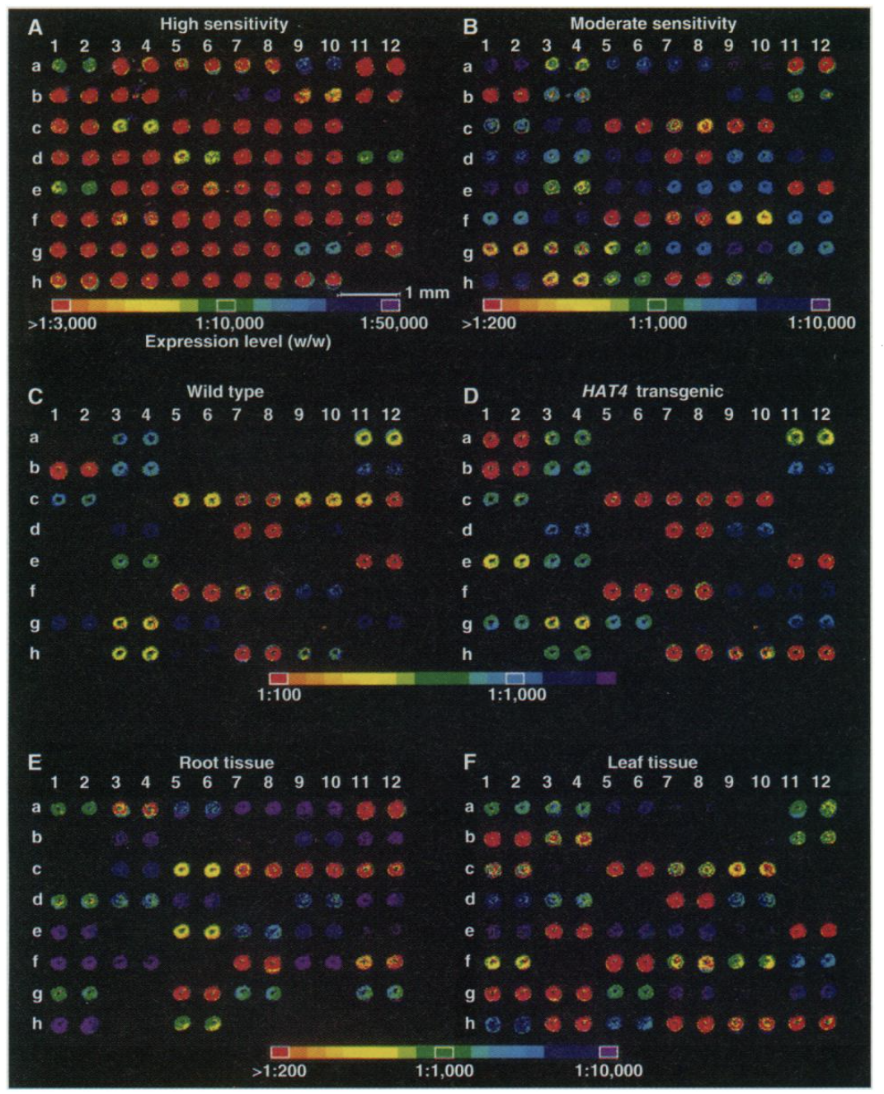
RNA-seq vs Microarrays
RNA-seq has greater dynamic range
Microarrays are limited by number of probes on slide, so signal can max out
RNA-seq is usually more sensitive
Can pick up more subtle changes
RNA-seq is not dependent upon a priori knowledge of gene sequence
Microarrays require you to print a set of probes, requiring knowledge of the transcript sequence
RNA-seq can detect novel transcripts
Schena et al. (1995) Science

Slide 3
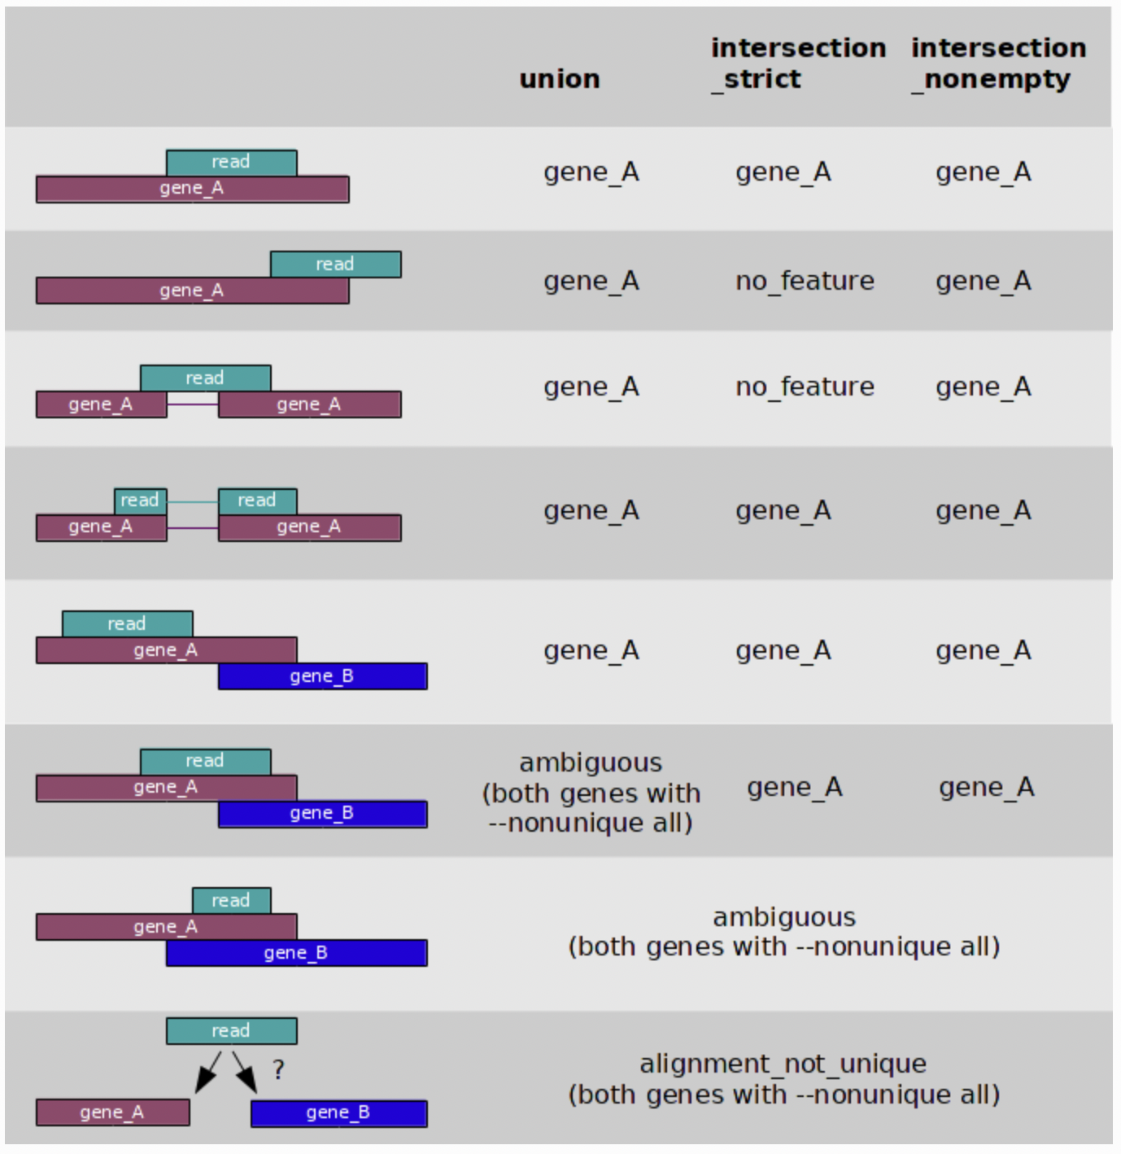
Read Counts
Number of reads or read-pairs mapping to a transcript
More complicated than it might seem
Stranded vs Unstranded data
Overlapping genes/transcripts
Isoforms (Introns & UTRs)
https://htseq.readthedocs.io/en/master/htseqcount.html

Slide 4
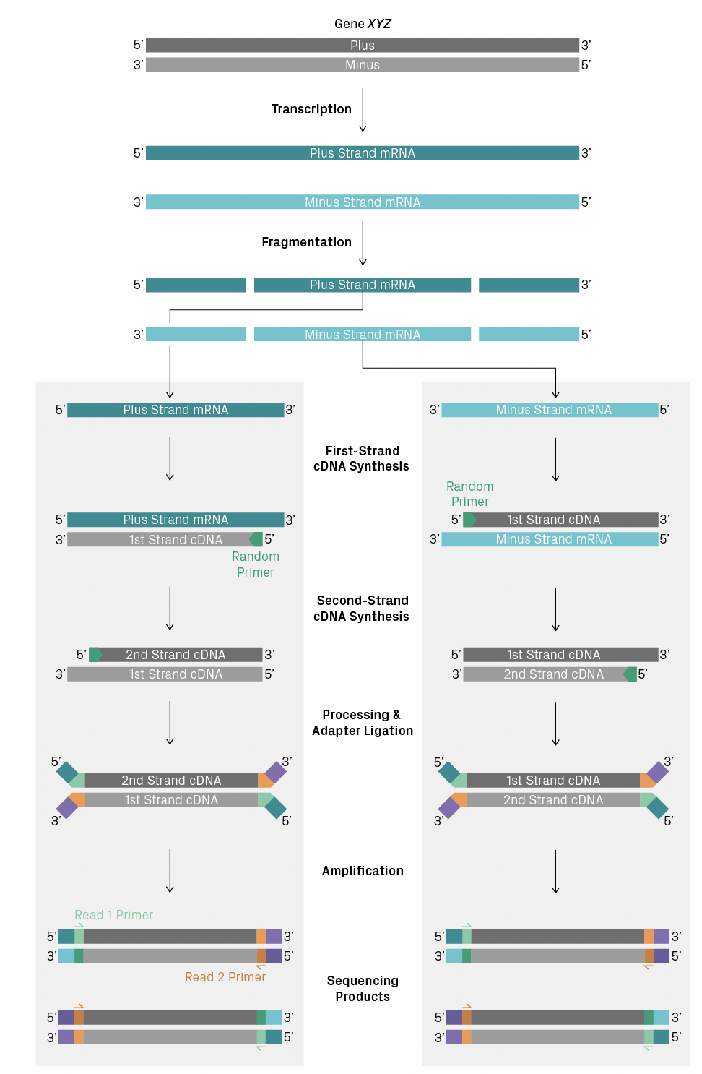
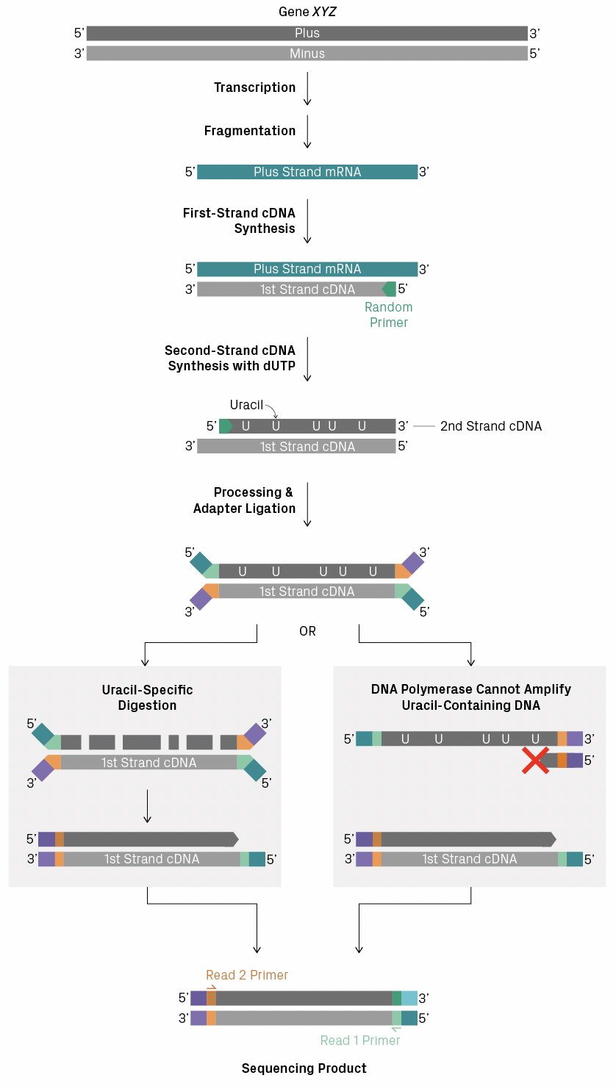
Stranded vs Un-stranded Data
Unstranded
Stranded
Unstranded RNA-seq libraries
You do not know which strand the transcript came from
Stranded RNA-seq libraries
You retain the information about which strand the transcript originated from
If at all possible, use stranded libraries
https://www.azenta.com/blog/stranded-versus-non-stranded-rna-seq

Slide 5
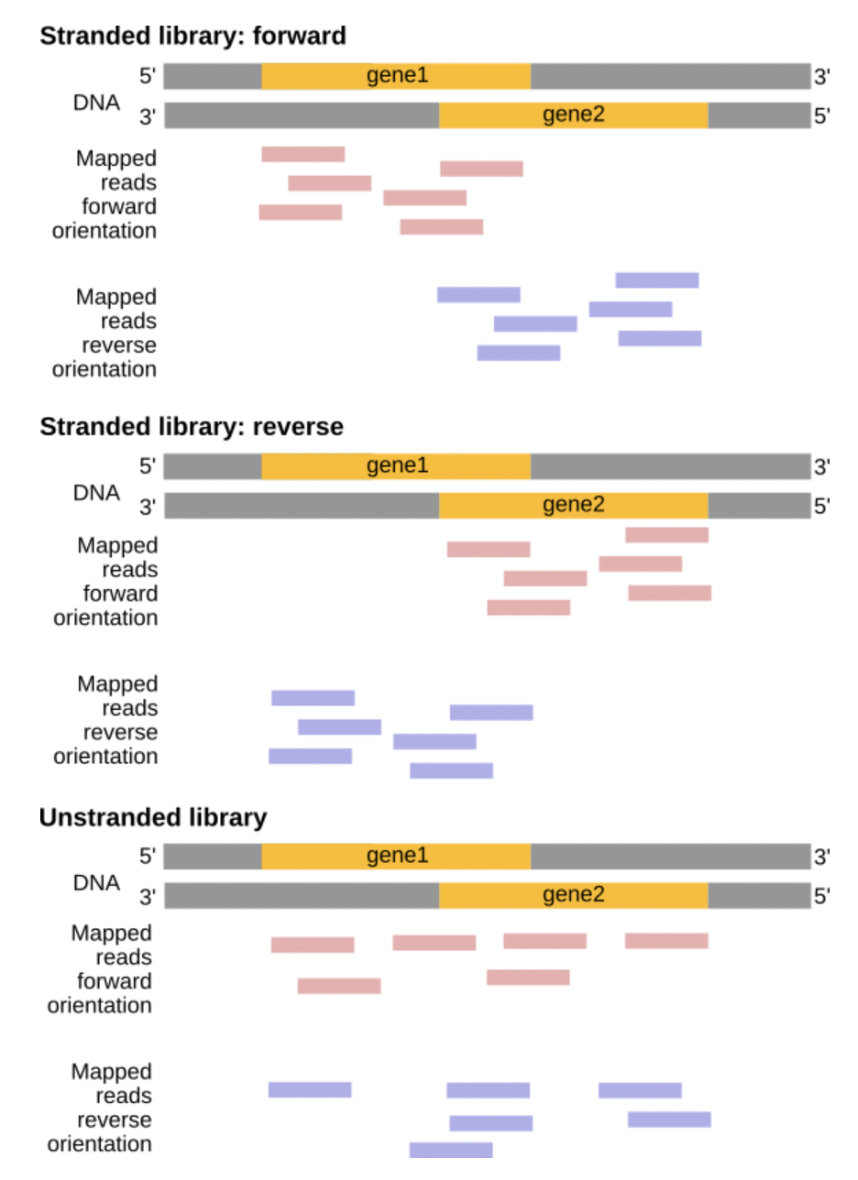
Stranded vs Un-stranded Data
Stranded libraries can help identify which gene a read came from
Especially useful for overlapping genes
Better for transcript assembly & identifying isoforms
They can also identify cases of anti-sense transcription
https://galaxyproject.github.io/training-material/topics/transcriptomics/tutorials/ref-based/tutorial.html

Slide 6
From Alignments to Read Counts
htseq-count
https://htseq.readthedocs.io/en/master/htseqcount.html
htseq is a python library for working with sequencing data formats
htseq-count is specific script within the htseq library
STAR
Has built in argument to output read counts using htseq-count
https://htseq.readthedocs.io/en/master/htseqcount.html
See --quantMode argument
RSEM
http://deweylab.github.io/RSEM/
Can be used to quantify transcripts/genes & extract read mapping

Slide 7
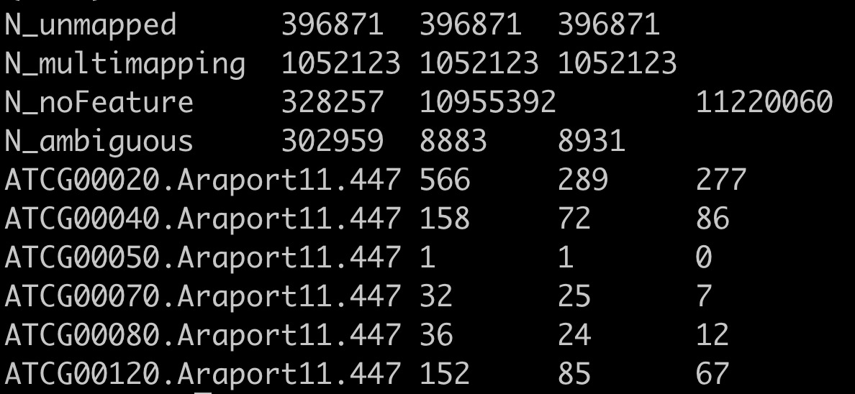
From Alignments to Read Counts
htseq-count & STAR count tables
Four rows of uninformative reads for differential expression
STAR puts out 4 columns:
Column 1: gene ID
Column 2: unstranded counts
Column 3: 1st read strand counts htseq-count option -syes
Column 4: 2nd read strand counts htseq-count option -s reverse

Slide 8
Data Normalization
https://www.rna-seqblog.com/rpkm-fpkm-and-tpm-clearly-explained/
For comparison of transcripts/genes within a sample we must normalize based on gene length
Longer transcripts produce more reads/fragments than shorter transcripts even if expressed at same level
Transcript length normalization is not necessary for differential expression of the same gene between conditions
The transcripts are the same length
Normalizing for gene length may violate assumptions of underlying statistical models, such as those in DESeq2 or EdgeR
Reads Per Kilobase Million (RPKM)/Fragments Per Kilobase Million (FPKM)
Older method, generally should use TPM
(Total reads or read pairs/Millions of reads)/Kilobases of Transcript
Each read comes from a fragment, for paired-end reads, the two paired-reads represent a single fragment
RPKM = FPKM for single-end reads
Use FPKM for paired-end reads
Transcripts Per Million (TPM)
Newer, more robust, preferred method
Reverses order of operation
(Reads or read pair per transcript/kilobases of transcript)/millions of reads after normalization
First part results in reads per kilobase (RPK), we then sum up this value across transcripts to get our “per million” and normalized on that

Slide 9
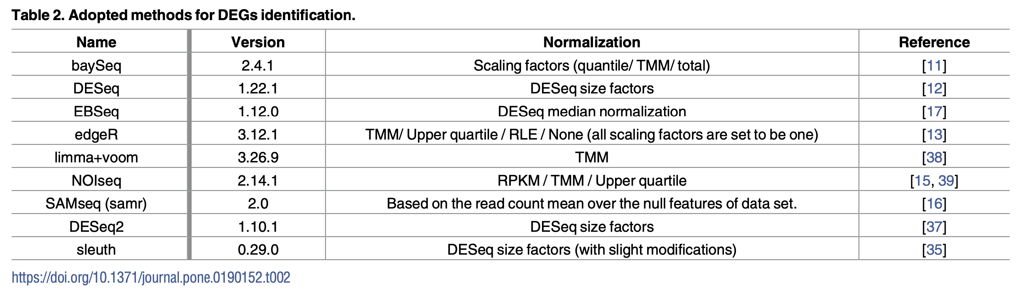
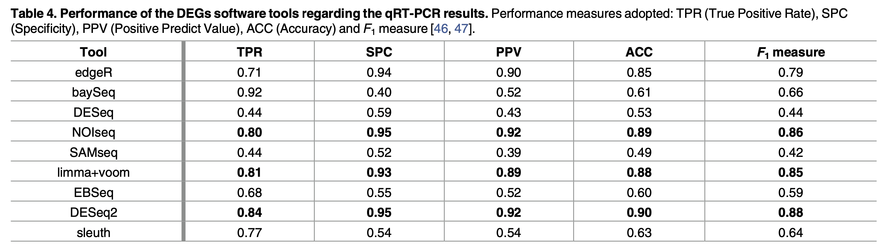
Differential Expression Tools
Multiple methods & packages have been developed for differential gene expression
Normalization methods differ between each
DESeq2 has overall best performance
Costa-Silva (2017) PLoS One

Slide 10
DESeq2
https://bioconductor.org/packages/release/bioc/vignettes/DESeq2/inst/doc/DESeq2.html
Most commonly used method for differential gene expression
Probably most robust & accurate method
Can accommodate models for more complex experimental designs
Lots of powerful functions for downstream analysis
Assumes raw count data – NO PRIOR NORMALIZATION
https://bioconductor.org/packages/release/bioc/vignettes/DESeq2/inst/doc/DESeq2.html#why-un-normalized-counts

Slide 11
Importing into R
Components
Read Counts
Sample metadata
Importing
https://bioconductor.org/packages/release/bioc/vignettes/DESeq2/inst/doc/DESeq2.html#the-deseqdataset
Tximport
http://bioconductor.org/packages/release/bioc/html/tximport.html
Allows import of transcript abundance from methods like Salmon/Kallisto/RSEM
Can summarize transcript abundance to gene-level counts
These are estimated counts (not truly raw counts)

Slide 12
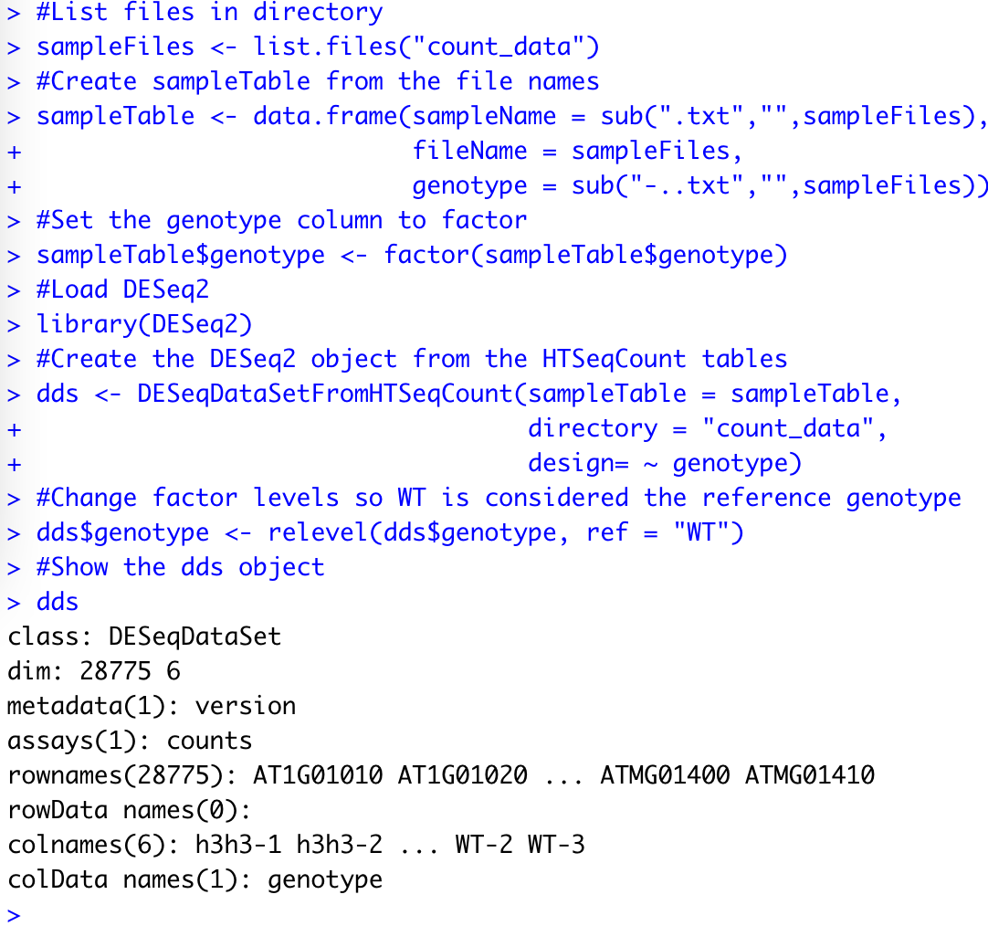
Importing into R
Example data & script in “count_data”
Data from an old paper of mine, unstranded, single-end short (<50 bp reads)
These are TAIR10 annotations
6 samples
3 Wild-Type
3 h3h3 (hae-3 hsl2-3 mutant)
We will load from htseq-count tables

Slide 13
Importing into R
design = ~ condition
Tells DESeq2 the experimental design
This is a simple comparison of wild-type and mutant, so there is one factor to consider (more complex designs can be done).
By default, DESeq2 uses alphabetical order to determine which factor to consider the reference, we can change this using relevel()

Slide 14
To Prefilter or Not To Prefilter?
Genes with very low counts have too little data to detect differential expression
Purpose of prefiltering is to remove these genes to reduce the number of statistical tests performed and so improve our ability to detect differentially expressed genes after multiple testing correction
We have to run statistical tests on each set of genes to determine differential expression
There are tens of thousands of genes
This leads to the issue of Multiple Comparisons and the need for Multiple Testing Correction
Prefiltering is not required, make your own judgement
General guideline for prefiltering is to remove any row (gene) if the total read count across all samples is less than 10
https://bioconductor.org/packages/release/bioc/vignettes/DESeq2/inst/doc/DESeq2.html#pre-filtering
For a simple experimental design with 2 conditions and 3 reps each (6 samples) this is ~1.666 reads per sample
https://bioconductor.org/packages/release/bioc/vignettes/DESeq2/inst/doc/DESeq2.html#pre-filtering

Slide 15
Multiple Testing
Multiple Comparisons Problem
https://en.wikipedia.org/wiki/Multiple_comparisons_problem
As the number of statistical tests (comparisons) performed increases, the chance of a false positive increases
In genomics we often conduct thousands to tens of thousands of tests
This means that if you conduct multiple tests and use a p-value cutoff of 0.05 the rate of false positives will be higher than 5%
Statistical methods have been developed to reduce rate false-positives
Multiple Testing Correction
https://www.nature.com/articles/nbt1209-1135
Benjamini-Hochberg & Bonferroni most commonly used
Bonferroni too strict generally for differential expression, common in GWAS
BH most common for differential expression

Slide 16
Multiple Testing
DESeq2
Includes multiple testing correction by default
padj (adjusted p-value) column
https://bioconductor.org/packages/release/bioc/vignettes/DESeq2/inst/doc/DESeq2.html#p-values-and-adjusted-p-values
p.adjust()
R command for doing common multiple testing corrections
df$padj <- p.adjust(df$p.value, method = “BH”)
Creates new column “df$padj” with the Benjamini-Hochberg adjustment of the column “df$p.value”

Slide 17
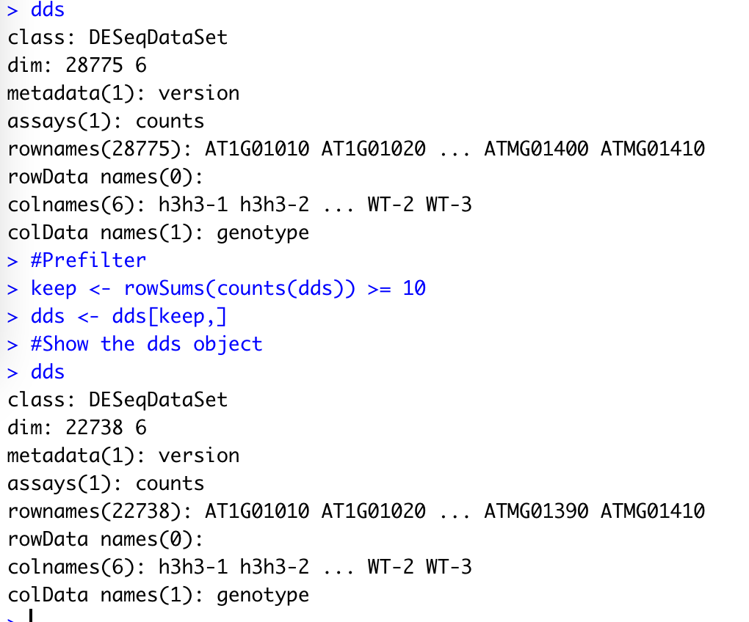
Prefiltering
Notice the differences in the dimensions
Before: 28775 genes
After: 22738 genes
6037 genes filtered as too low expression...that is 6037 fewer statistical tests performed

Slide 18
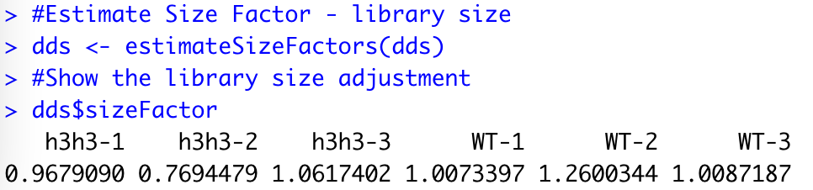
Data Normalization – DESeq2
DESeq2 normalizes read counts by library size, not gene/transcript length
DESeq2 is for comparing same gene/transcript between conditions, not between different genes
Length normalized data will violate the assumptions of the DESeq2 model (this is generally true of methods like EdgeR as well)

Slide 19
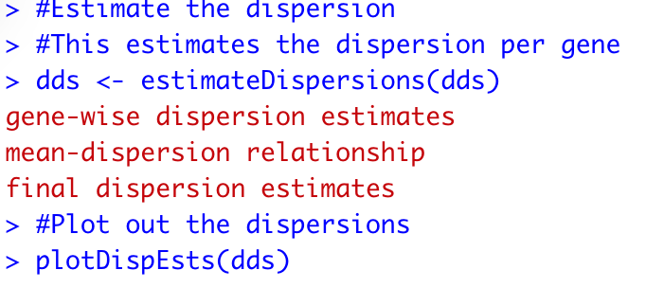
Negative Binomial Distribution
RNA-seq data is modeled using the Negative Binomial Distribution
Poisson distribution models discrete data assuming that the variance is equal to the mean
RNA-seq count data typically is over-dispersed, meaning that the variance is often much larger than the mean
Poisson distribution does not apply
In a negative binomial, the variance can be different than the mean, making it ideal for RNA-seq count data

Slide 20
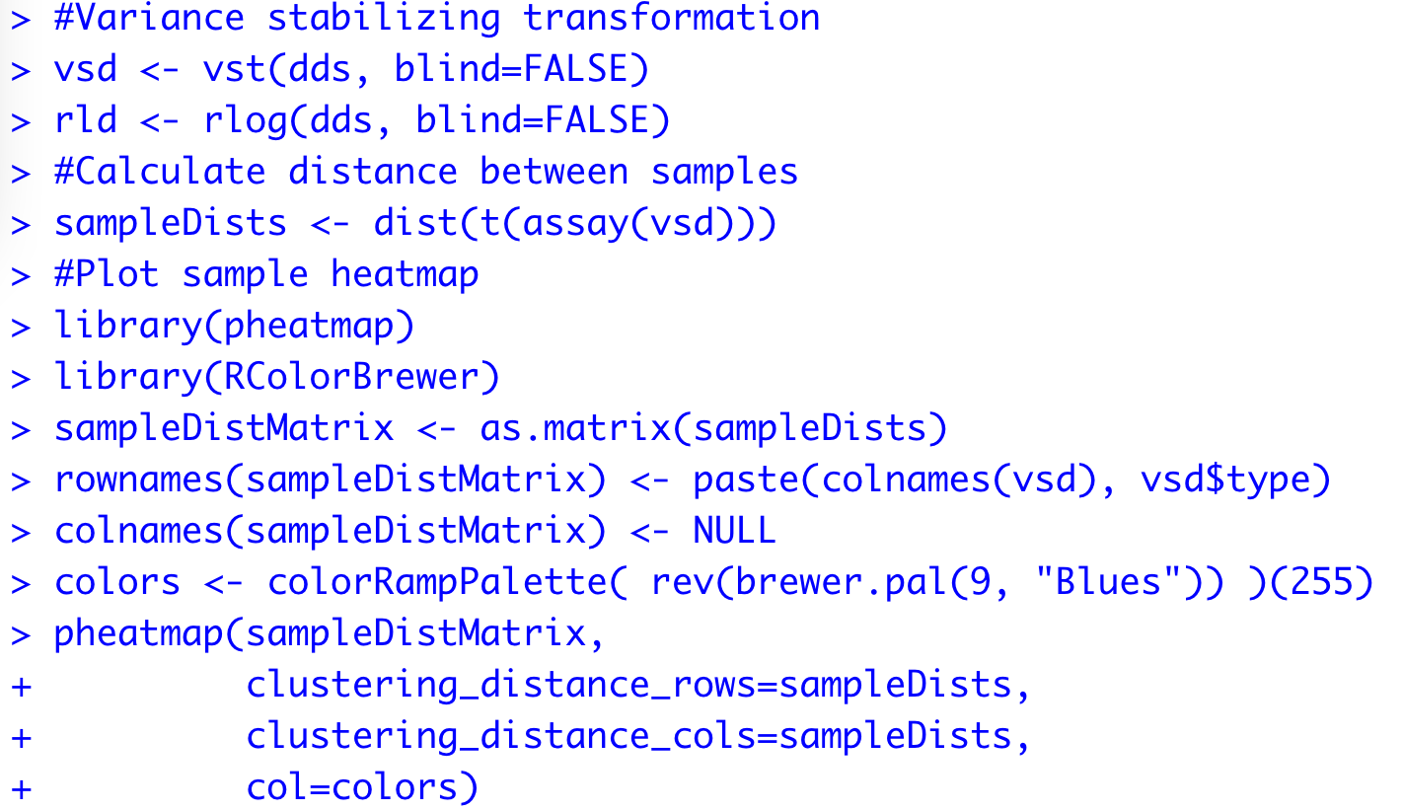
Quality Control
Are there outlier samples?
These can be detected by clustering and principle component analysis (PCA)
https://bioconductor.org/packages/release/bioc/vignettes/DESeq2/inst/doc/DESeq2.html#data-quality-assessment-by-sample-clustering-and-visualization
For these steps it is better to transform the data
https://bioconductor.org/packages/release/bioc/vignettes/DESeq2/inst/doc/DESeq2.html#count-data-transformations
Two primary means in DESeq2
variance stabilizing transformation (vst)
regularize logarithm (rlog)
We will use vst

Slide 21
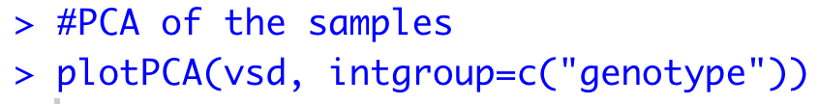
Quality Control
PCA and heatmap will reveal some differences
Notice that there seems to be more variation in the WT, but the two conditions still cluster together very well in both the heatmap and the WT
PC1 explains 75% of the variance, which appears to be the genotype

Slide 22
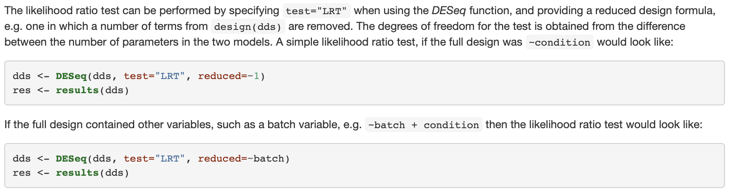
Calling Differential Expression (DESeq2)
Wald Test
The default – used for most experiments
“Uses the estimated standard error of a log2 fold change to test if it is equal to zero”
https://bioconductor.org/packages/release/bioc/vignettes/DESeq2/inst/doc/DESeq2.html#likelihood-ratio-test
Likelihood Ratio Test (LRT)
Tests both a “full model” with all the effect terms (multiple factors) and a “reduced model” with some of the effect terms removed.
ANODEV (analysis of deviance): testing the difference in likelihood between the two models.
Think of this as similar to doing an ANOVA
The LRT is useful for complex experimental designs with multiple factors & interactions
https://bioconductor.org/packages/release/bioc/vignettes/DESeq2/inst/doc/DESeq2.html#likelihood-ratio-test

Slide 23
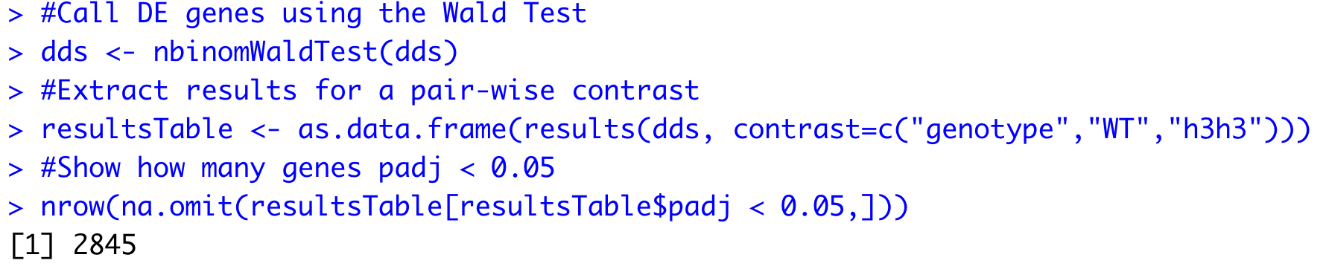
Calling Differential Expression

Slide 24
Setting Cutoffs
What do we consider statistically meaningful?
Decisions to apply a cutoff are somewhat arbitrary and dependent upon your experience & biological intuition
p-values
Sort of measure of how confident we are something is true
Use with some caution
A significant p-value is not always meaningful
Standard default is p-value < 0.05
Used because this was Fisher’s default if you will
Good luck convincing someone to accept a higher value
Some prefer 0.001 or even 0.0001
fold-change
How much does the expression differ between treatment groups?
Think of this as the effect size
Larger the sample size, can call smaller fold-changes as statistically significant
Keep in mind, small differences in expression may be important, especially for regulatory genes or in bulk tissue samples

Slide 25
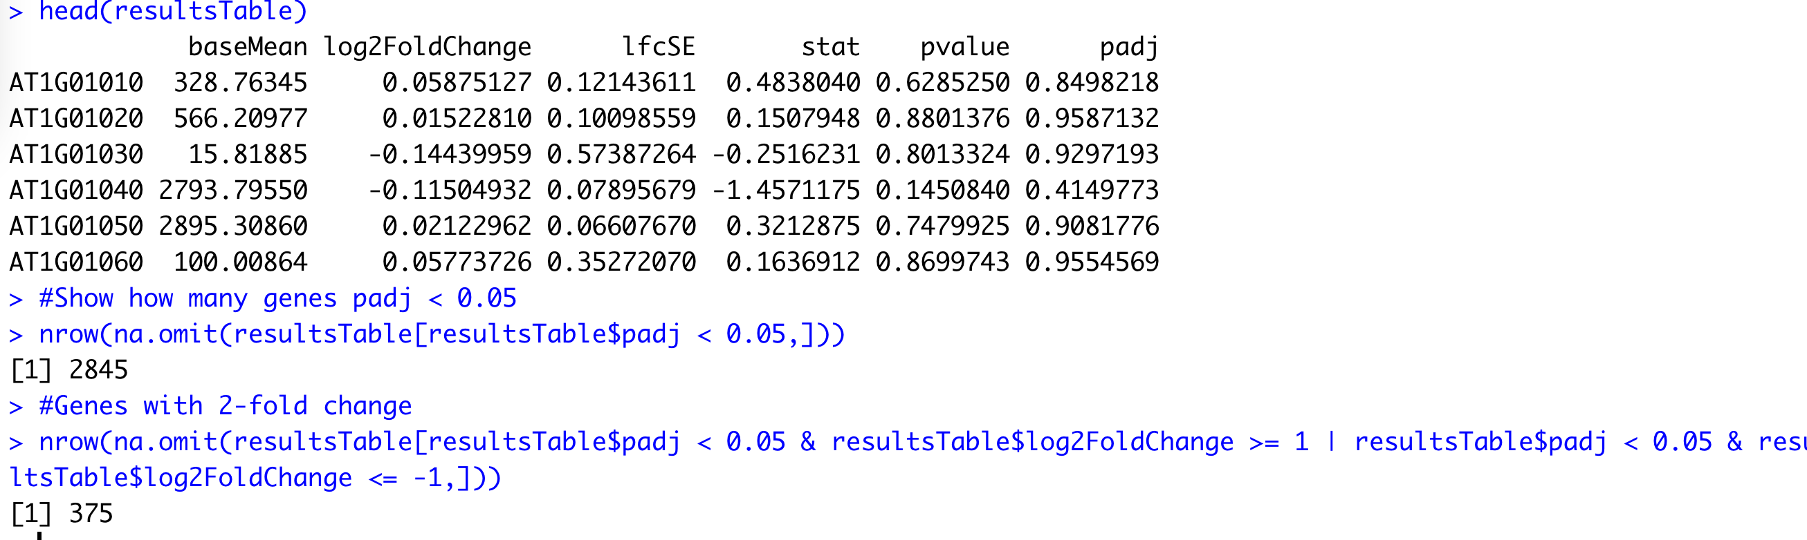
Setting Cutoffs

Slide 26
Plotting Results – Global Changes
Volcano Plots (MA plots)
Plots log 2 fold change (y-axis) against the mean normalized read count (x-axis)
built in function plotMA()
Sample vs Sample Dot Plots
Plotting the mean of one condition against the mean of the other

Slide 27
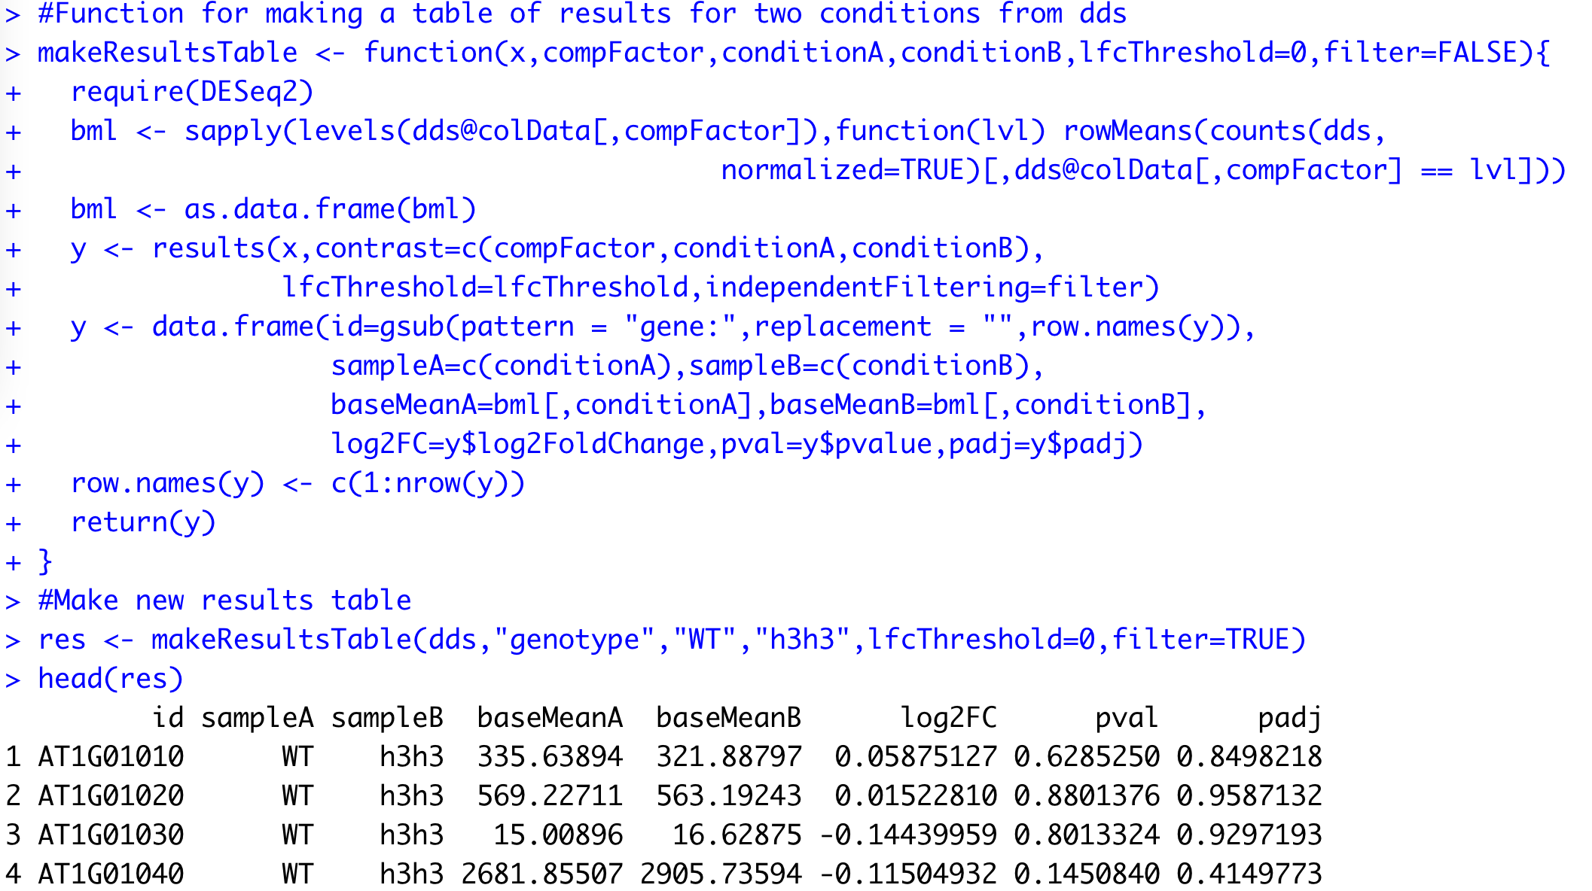
Plotting Results – Global Changes
Sample vs Sample Dot Plots
Plotting the mean of one condition against the mean of the other
Here I create a function for adding the mean counts for each condition into a table with log2FC & adjusted p-value

Slide 28
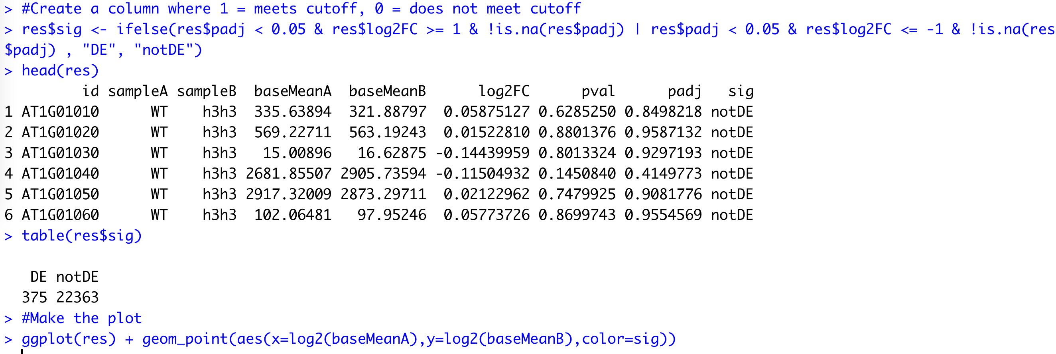
Plotting Results – Global Changes
Sample vs Sample Dot Plots
Plotting the mean of one condition against the mean of the other
I now create a new column, that will indicate which genes make the cutoff and which dont
These are then plotted using ggplot2

Slide 29
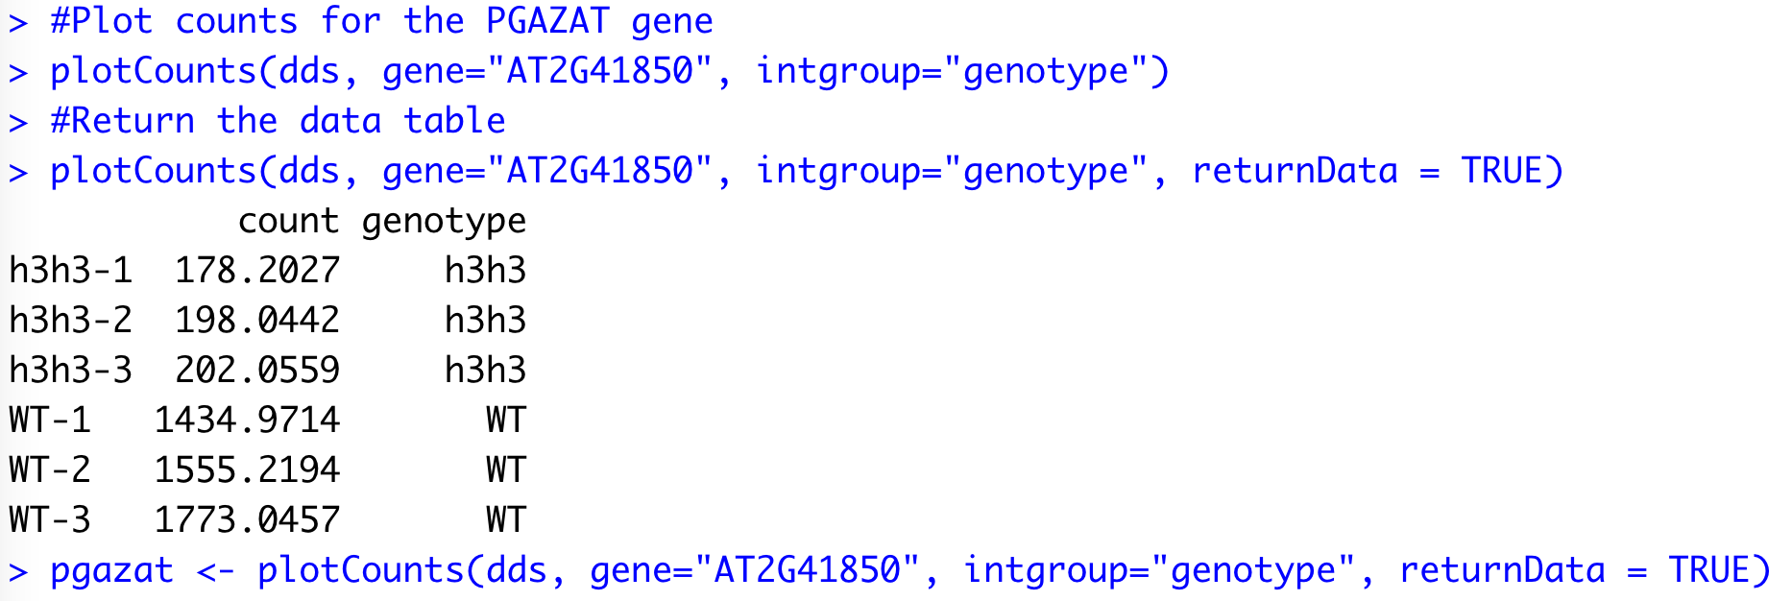
Plotting Results – Individual Changes
DESeq2 has built in function for extracting and plotting counts for individual genes
plotCounts()
using argument “returnData = TRUE” can extract out normalized read counts as a table

Slide 30
Upcoming
Work on your proposals!
Today
Lab Assignment #4 due @ 5pm
Lab Assignment #5 assigned
10/17 Lecture 7: Proteomics & Metabolomics
Papers on D2L
10/19 Lab 7: Gene Function & Gene Ontology
Lab Assignment #5 due @ 5pm
Lab Assignment #6 assigned

